Slide 1
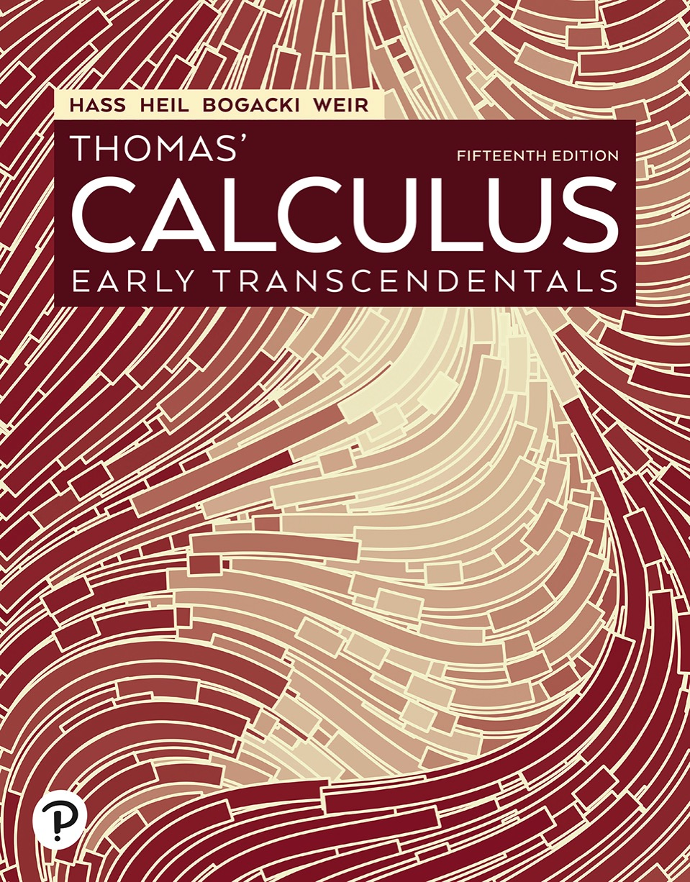

Thomas’ Calculus: Early Transcendentals
Fifteenth Edition
Chapter 12
Vectors and the Geometry of Space
Copyright © 2023, 2018, 2014 Pearson Education, Inc. All Rights Reserved
Notes:
If this PowerPoint presentation contains mathematical equations, you may need to check that your computer has the following installed:
1) MathType Plugin
2) Math Player (free versions available)
3) NVDA Reader (free versions available)

Slide 2
Section 12.1 Three-Dimensional Coordinate Systems

Slide 3
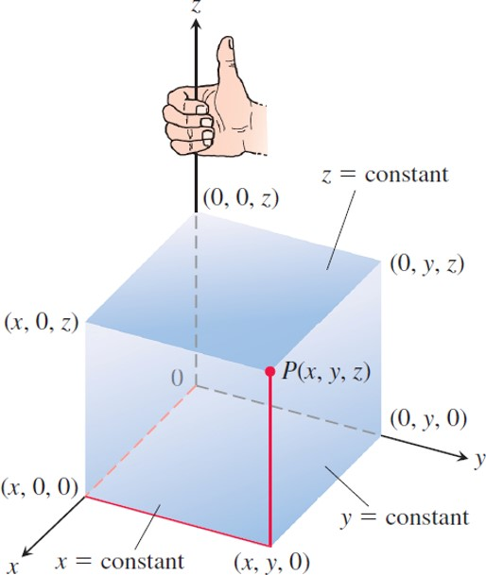
Three-Dimensional Coordinate Systems (1 of 5)
The Cartesian coordinate system is right-handed.
Notes:
The vertices of the cube are (x, 0, 0), (x, 0, z), (0, 0, z), (0, y, z), (0, y, 0), (x, y, 0), and (x, y, z). The vertex at (x, y, z) is at point p that is perpendicular to the axes. The values, x, y, and z, are labeled constant.

Slide 4
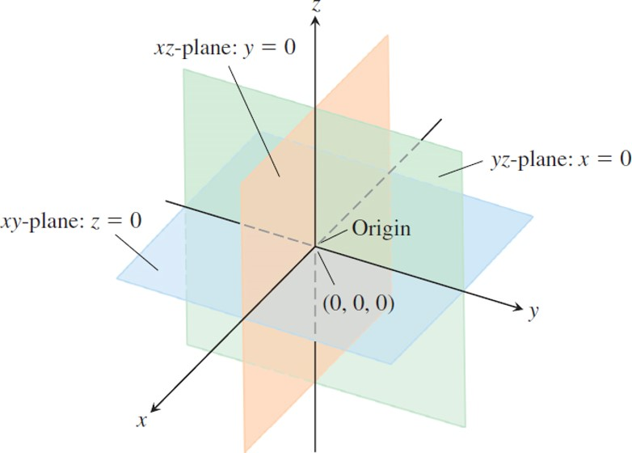
Three-Dimensional Coordinate Systems (2 of 5)
The planes x = 0, y = 0, and z = 0 divide space into eight octants.

Slide 5
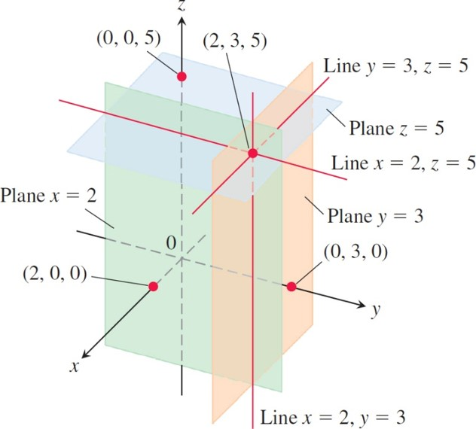
Three-Dimensional Coordinate Systems (3 of 5)
The planes x = 2, y = 3, and z = 5 determine three lines through the point (2, 3, 5).
Notes:
Each of the three planes determines three lines passing through the plane. Plane x = 2 with a point (2, 0, 0) determines the line at y = 3 and z = 5. Plane y = 3 with a point (0, 3, 0) determines a line at x = 2 and z = 5. Plane z = 5 has point (0, 0, 5) determining a line at x = 2, y = 3. The planes have a point of inflection at (2, 3, 5).

Slide 6
Three-Dimensional Coordinate Systems (4 of 5)
Example: We interpret these equations and inequalities geometrically.
The half-space consisting of the points on and above the x y-plane.
The plane perpendicular to the x-axis
at
This plane lies parallel to the
y z-plane and 3 units behind it.
The second quadrant of the x y-plane.

Slide 7
Three-Dimensional Coordinate Systems (5 of 5)
Example (concluded):
The first octant.
(e)
The slab between the planes
and y = 1 (planes included).
The line in which the planes
and z = 2 intersect. Alternatively,
the line through the point
parallel to the x-axis.

Slide 8
Distance and Spheres in Space (1 of 7)
The Distance Between

Slide 9
Distance and Spheres in Space (2 of 7)
Example: The distance between
and
is

Slide 10
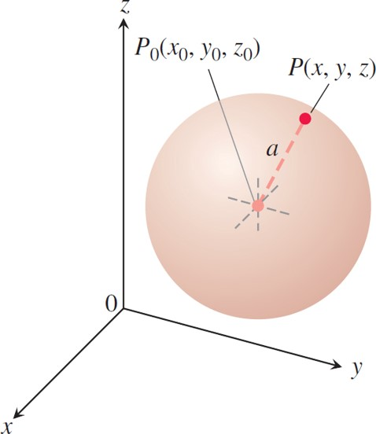
Distance and Spheres in Space (3 of 7)
The sphere of radius a centered at the point

Slide 11
Distance and Spheres in Space (4 of 7)
The Standard Equation for the Sphere of
Radius a and Center

Slide 12
Distance and Spheres in Space (5 of 7)
Example: Find the center and radius of the sphere
Solution: Complete the squares on the
and z-terms as necessary and write each quadratic as a squared linear expression. For the sphere here, we have

Slide 13
Distance and Spheres in Space (6 of 7)
Solution (continued):

Slide 14
Distance and Spheres in Space (7 of 7)
Solution (concluded):
From this standard form, we read that
The
center is
The radius is

Slide 15
Section 12.2 Vectors

Slide 16
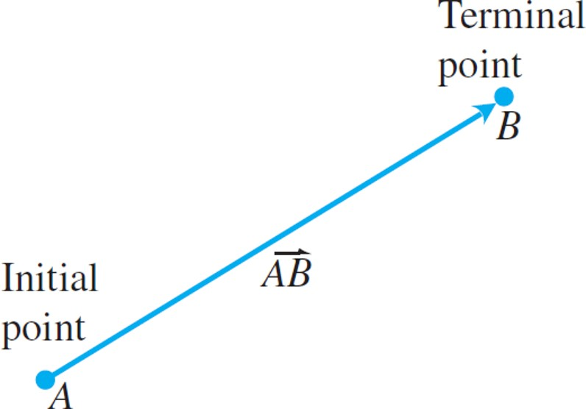
Component Form (1 of 9)
The directed line segment
is called a vector.

Slide 17
Component Form (2 of 9)
Definitions: The vector represented by the
directed line segment
has initial point
A and terminal point B and its length is
denoted by
Two vectors are equal
if they have the same length and direction.

Slide 18
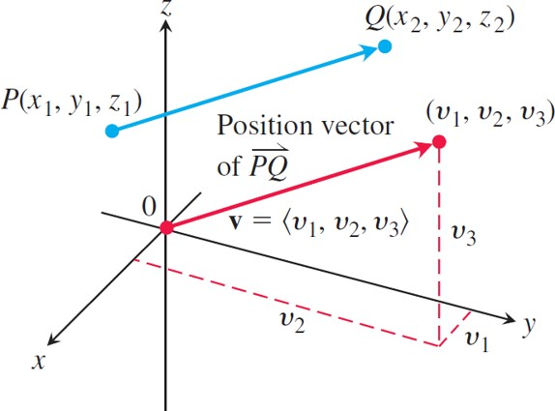
Component Form (3 of 9)
A vector
in standard position has its initial
point at the origin. The directed line segments
and v are parallel and have the same length.
Notes:
Vector P Q with initial point, P, at (x sub 1, y sub 1, z sub 1) and terminal point, Q, at (x sub 2, y sub 2, z sub 2) pointing toward the northeast direction. The position vector of P Q is v with initial point at the origin and terminal point at (v sub 1, v sub 2, v sub 3). The positive y axis has a parallel run line, v sub 2, that inflects with a line, v sub 1, that is parallel to the x axis. A vertical dashed line, v sub 3, toward point (v sub 1, v sub 2, v sub 3) arises from the point of inflection between the lines v sub 2 and v sub 1.

Slide 19
Component Form (4 of 9)
Definition: If v is a two-dimensional vector in the plane equal to the vector with initial point at the origin and
terminal point
then the component form of v is
If v is a three-dimensional vector equal to the vector
with initial point at the origin and terminal point
then the component form of v is

Slide 20
Component Form (5 of 9)
The magnitude or length of the vector
is the nonnegative number

Slide 21
Component Form (6 of 9)
Example: Find the (a) component form and (b) length
of the vector with initial point
and terminal
point
Solution:
(a) The standard position vector v representing
has components
and

Slide 22
Component Form (7 of 9)
Solution (concluded):
The component form of
(b) The length or magnitude of

Slide 23
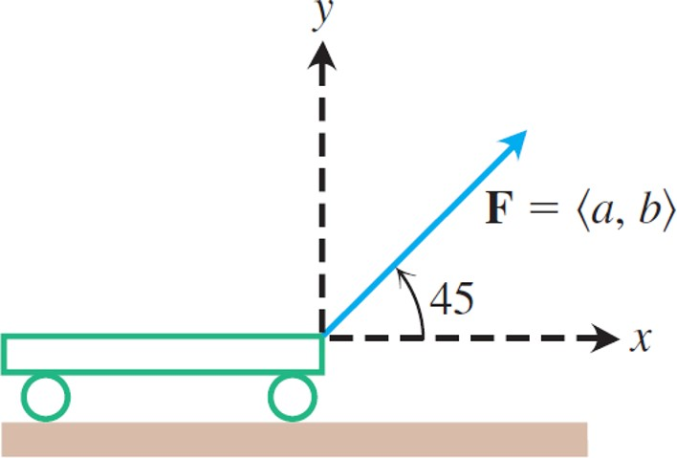
Component Form (8 of 9)
The force pulling the cart forward is represented by the vector F whose horizontal component is the effective force.

Slide 24
Component Form (9 of 9)
Example: A small cart is being pulled along a smooth horizontal floor with a 20-l b force F making a
angle to the floor. What is the effective force
moving the cart forward?
Solution: The effective force is the horizontal
component of
given by
Notice that F is a two-dimensional vector.

Slide 25
Vector Algebra Operations (1 of 5)
Definitions: Let
be vectors with k a scalar.
Addition:
Scalar multiplication:

Slide 26
Vector Algebra Operations (2 of 5)
Example: Let
Find the components of
(a)
(b)
(c)

Slide 27
Vector Algebra Operations (3 of 5)
Solution:
(a)
(b)
(c)

Slide 28
Vector Algebra Operations (4 of 5)
Properties of Vector Operations
Let u, v, w be vectors and a, b be scalars.
1.
2.
3.
4.
5.

Slide 29
Vector Algebra Operations (5 of 5)
6.
7.
8.
9.

Slide 30
Unit Vectors (1 of 3)
A vector v of length 1 is called a unit vector. The standard unit vectors are

Slide 31
Unit Vectors (2 of 3)
Example: Find a unit vector u in the direction of the
vector from
Solution: We divide
by its length:
This unit vector u is the direction of

Slide 32
Unit Vectors (3 of 3)
If
then
1.
is a unit vector called the direction of v;
2. the equation
expresses v as its
length times its direction.

Slide 33
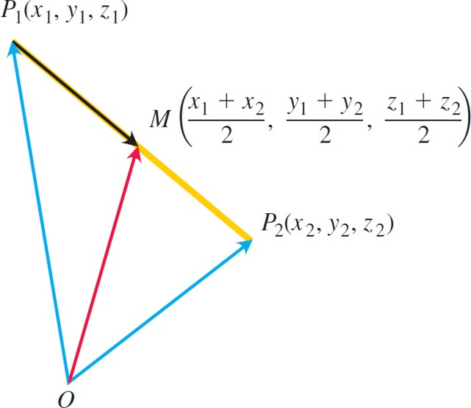
Midpoint of a Line Segment (1 of 3)
The coordinates of the midpoint are the averages of
the coordinates of
Notes:
The illustration has three vectors with initial point from O. Vector, P sub 1 (x sub 1, y sub 1, z sub 1), extends toward the left from point 0. Vector, P sub 2 (x sub 2, y sub 2, z sub 2), extends toward the right from 0. Vector, M (start fraction x sub 1 + x sub 2 over 2 end fraction, start fraction y sub 1 + y sub 2 over 2 end fraction, start fraction z sub 1 + z sub 2 over 2 end fraction), extends at the center from point 0. A line is drawn between the terminal points of the three vectors. A vector extends from the terminal point of vector p toward M.

Slide 34
Midpoint of a Line Segment (2 of 3)
The midpoint M of the line segment joining
points
is the point

Slide 35
Midpoint of a Line Segment (3 of 3)
Example: The midpoint of the segment
joining
is

Slide 36
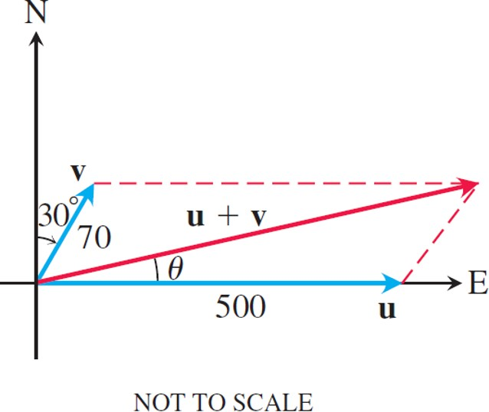
Applications (1 of 9)
Vectors representing the velocities of the airplane u and tailwind v.
Notes:
Vector u is on the x axis and vector v is 30 degrees from the y axis to the right. Dashed lines are drawn forming a parallelogram. A diagonal labeled, u + v, starts from the origin. The length of u is 500 and v is 70. The angle between u and u + v is theta.

Slide 37
Applications (2 of 9)
Example: A jet airliner, flying due east at 500 miles per hour in still air, encounters a 70-miles per hour tailwind
blowing in the direction
north of east. The
airplane holds its compass heading due east but, because of the wind, acquires a new ground speed and direction. What are they?

Slide 38
Applications (3 of 9)
Solution: If u is the velocity of the airplane alone
and v is the velocity of the tailwind, then
and
The velocity of the airplane with respect
to the ground is given by the magnitude and direction of the resultant vector u + v. If we let the positive x-axis represent east and the positive y-axis represent north, then the component forms of u and v are

Slide 39
Applications (4 of 9)
Solution (concluded):
Therefore,
and
The new ground speed of the airplane is about 538.4 miles per hour, and its new direction is about

Slide 40
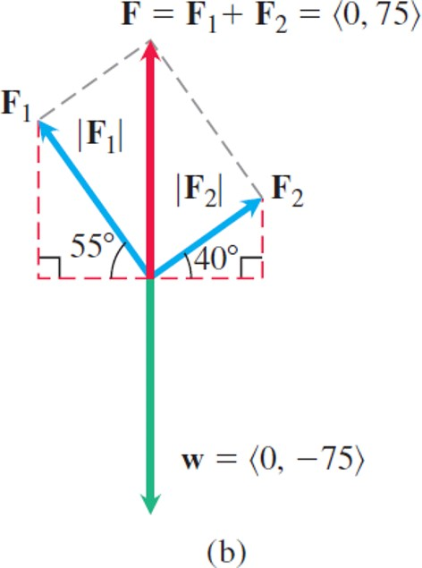
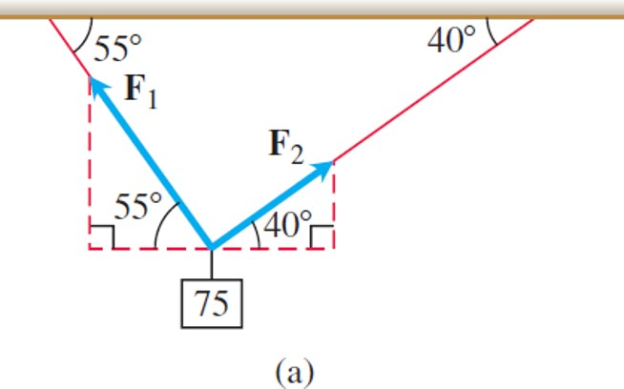
Applications (5 of 9)
The suspended weight.

Slide 41
Applications (6 of 9)
Example: A 75-N weight is suspended by two wires,
as shown above. Find the forces
acting in
both wires.
Solution: The force vectors
have magnitudes
and components that are measured in
newtons. The resultant force is the sum
and must be equal in magnitude and acting in the opposite (or upward) direction to the weight vector w (see above). It follows from the figure that

Slide 42
Applications (7 of 9)
Solution (continued):
Since
the resultant vector leads to the system
of equations
Solving for
in the first equation and substituting the
result into the second equation, we get

Slide 43
Applications (8 of 9)
Solution (continued):
It follows that
and

Slide 44
Applications (9 of 9)
Solution (concluded):
The force vectors are then
and

Slide 45
Vectors in n Dimensions (1 of 3)
n-dimensional vector:
The magnitude or length of v:
Addition of two vectors:
Scalar multiplication of a vector by a real number:

Slide 46
Vectors in n Dimensions (2 of 3)
Example: The components of the vector
contain the average temperatures (in degrees Fahrenheit) recorded between the years 2006 and 2010 in Houston, Los Angeles, Miami, Minneapolis, and New York. Likewise, the vectors
represent average temperatures in the same cities over the periods 2011 through 2015 and 2016 through 2020. Find the vector whose components are the average temperatures between the year 2006 and the year 2020 in these cities.

Slide 47
Vectors in n Dimensions (3 of 3)
Solution: To find the vector containing average temperatures, we add scalar multiples of the three vectors (in other words, we evaluate a linear combination):

Slide 48
Section 12.3 The Dot Product

Slide 49
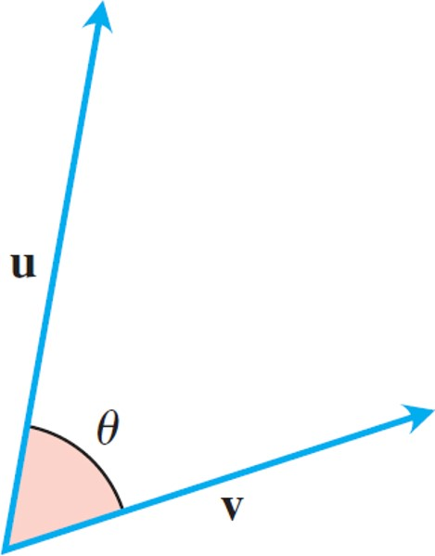
Angle Between Vectors (1 of 6)
The angle between u and v lies in the interval

Slide 50
Angle Between Vectors (2 of 6)
Theorem—Angle Between Two Vectors
The angle
between two nonzero vectors
is given by

Slide 51
Angle Between Vectors (3 of 6)
Definition: The dot product
(“u dot v”)
of vectors
is the scalar

Slide 52
Angle Between Vectors (4 of 6)
Example: We illustrate the definition.
(a)
(b)

Slide 53
Angle Between Vectors (5 of 6)
Dot Product and Angles
The angle between two nonzero vectors u
and v is
The dot product of two vectors u and v is
given by

Slide 54
Angle Between Vectors (6 of 6)
Example: Find the angle between
and
Solution: We use the formula above:

Slide 55
Orthogonal Vectors (1 of 3)
Definition: Vectors u and v are orthogonal if

Slide 56
Orthogonal Vectors (2 of 3)
Example: To determine if two vectors are orthogonal, calculate their dot product.
(a)
are orthogonal because
(b)
are orthogonal
because

Slide 57
Orthogonal Vectors (3 of 3)
(c) 0 is orthogonal to every vector u since

Slide 58
Dot Product Properties and Vector Projections (1 of 8)
Properties of the Dot Product
If u, v, and w are any vectors and c is a scalar, then
1.
2.
3.
4.
5.

Slide 59
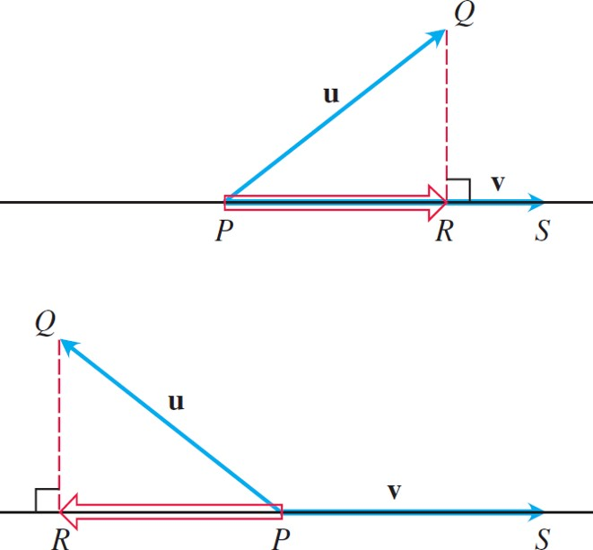
Dot Product Properties and Vector Projections (2 of 8)
The vector projection of u onto v.
Notes:
The first illustration has two vectors, u and v, that make an acute angle. Vector v is represented by line P S. Vector v aligns to the horizontal axis from P until point R. Vector u, represented by line P Q, points to the top right. A dotted line that is perpendicular from Q to v meets P S at point R. The second illustration depicts two vectors, u and v, that make an obtuse angle. Line P S that lies on the horizontal axis represents vector v. Line P Q that points to the top left represents vector u. A dotted line that is perpendicular from Q onto v meets P S at point R. The vector then extends in the opposite direction of v.

Slide 60
Dot Product Properties and Vector Projections (3 of 8)
The vector projection of u onto v is the vector
The scalar component of u in the direction of v is the scalar

Slide 61
Dot Product Properties and Vector Projections (4 of 8)
Example: Find the vector projection of
onto
and the scalar component of u in
the direction of v.
Solution: We find
from the Equation above:

Slide 62
Dot Product Properties and Vector Projections (5 of 8)
Solution (concluded):
We find the scalar component of u in the direction of v:

Slide 63
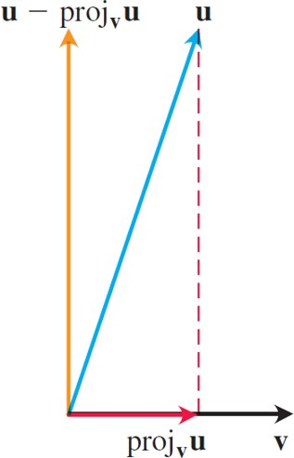
Dot Product Properties and Vector Projections (6 of 8)
The vector u is the sum of two perpendicular vectors:
a vector
parallel to v, and a vector
perpendicular to v.

Slide 64
Dot Product Properties and Vector Projections (7 of 8)
Example: Verify that the vector
is
orthogonal to the projection vector
Solution: The vector
is parallel to v.
So it suffices to show that the vector
is
orthogonal to v. We verify orthogonality by showing
that the dot product of
with v is zero:

Slide 65
Dot Product Properties and Vector Projections (8 of 8)
Solution (concluded):

Slide 66
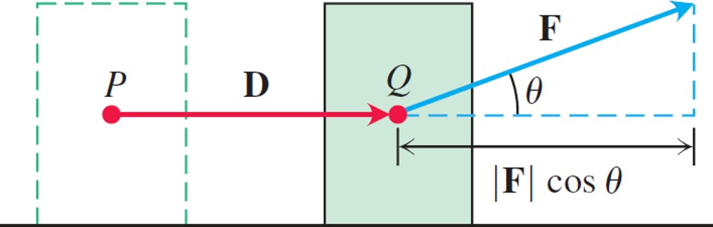
Work (1 of 3)
The work done by a constant force F during a
displacement D is
which is the dot
product

Slide 67
Work (2 of 3)
Definition: The work done by a constant
force F acting through a displacement
is

Slide 68
Work (3 of 3)
Example: If
and
the work done by F in acting from P
to Q is

Slide 69
Section 12.4 The Cross Product

Slide 70
The Cross Product of Two Vectors in Space (1 of 3)
Definition: The cross product
(“u cross v”) is the vector

Slide 71
The Cross Product of Two Vectors in Space (2 of 3)
Parallel Vectors
Nonzero vectors u and v are parallel if and
only if

Slide 72
The Cross Product of Two Vectors in Space (3 of 3)
Properties of the Cross Product
If u, v, and w are any vectors and r, s are scalars, then
1.
2.
3.
4.
5.
6.

Slide 73
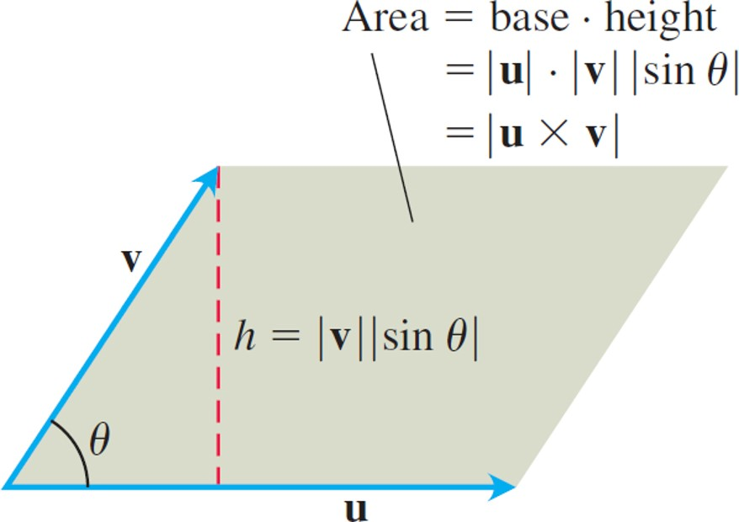
The Magnitude of Start Expression u Cross v End Expression Is the Area of a Parallelogram (1 of 2)
The parallelogram determined by u and v.
Notes:
The angle between the two sides of the parallelogram, u and v, is theta. The area of the parallelogram = base times height = the absolute value of u times the absolute value of v times the absolute value of sine of theta = the absolute value of start expression u cross v end expression. The height connects the edge of vector v and the base of vector u to form a right angle triangle with a formula of h = the absolute value of v times the absolute value of sine theta.

Slide 74
The Magnitude of Start Expression u Cross v End Expression Is the Area of a Parallelogram (2 of 2)

Slide 75
Determinant Formula for u Cross v (1 of 5)
Calculating the Cross Product as a Determinant
If
then

Slide 76
Determinant Formula for u Cross v (2 of 5)
Example: Find
Solution: We expand the symbolic determinant:

Slide 77
Determinant Formula for u Cross v (3 of 5)
Example: Find a vector perpendicular to the plane of
Solution: The vector
is perpendicular to the plane
because it is perpendicular to both vectors. In terms of components,

Slide 78
Determinant Formula for u Cross v (4 of 5)
Example: Find a unit vector perpendicular to the
plane of
Solution: Since
is perpendicular to the
plane, its direction n is a unit vector perpendicular to the plane. We have

Slide 79
Determinant Formula for u Cross v (5 of 5)
Solution (concluded):
For ease in calculating the cross product using determinants, we usually write vectors in the
form
rather than as ordered
triples

Slide 80
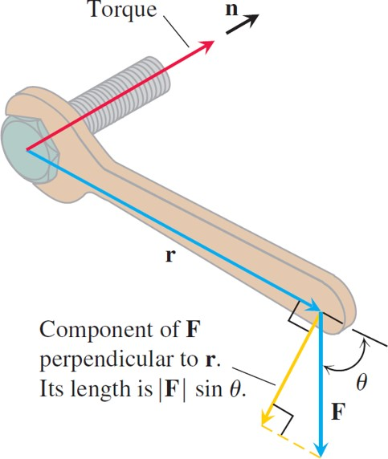
Torque (1 of 3)
The torque vector describes the tendency of the force F to drive the bolt forward.
Notes:
A vector, r, passes through the length of a wrench, and another vector, F, makes an angle of theta with r. The torque is in the direction of the bolt. A third vector, n, which is perpendicular to r, is the point where vector F intersects r. The vector is labeled component of F perpendicular to r. The length of the vector is F sine of theta.

Slide 81
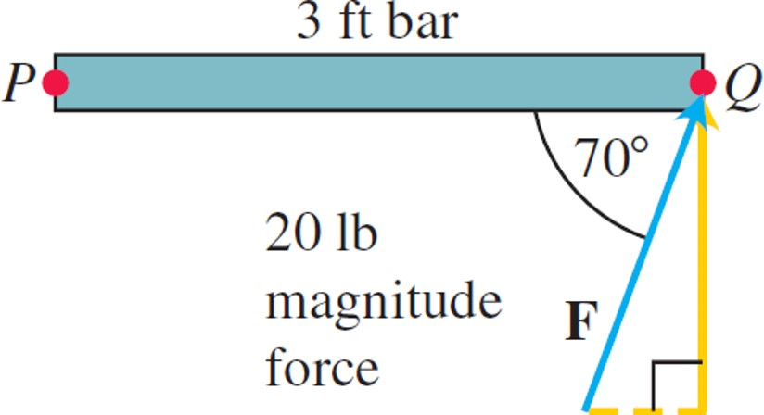
Torque (2 of 3)
The magnitude of the torque exerted by F at P is about 56.4 feet-l b. The bar rotates counterclockwise around P.

Slide 82
Torque (3 of 3)
Example: The magnitude of the torque generated by force F at the pivot point P in the Figure is
In this example the torque vector is pointing out of the page toward you.

Slide 83
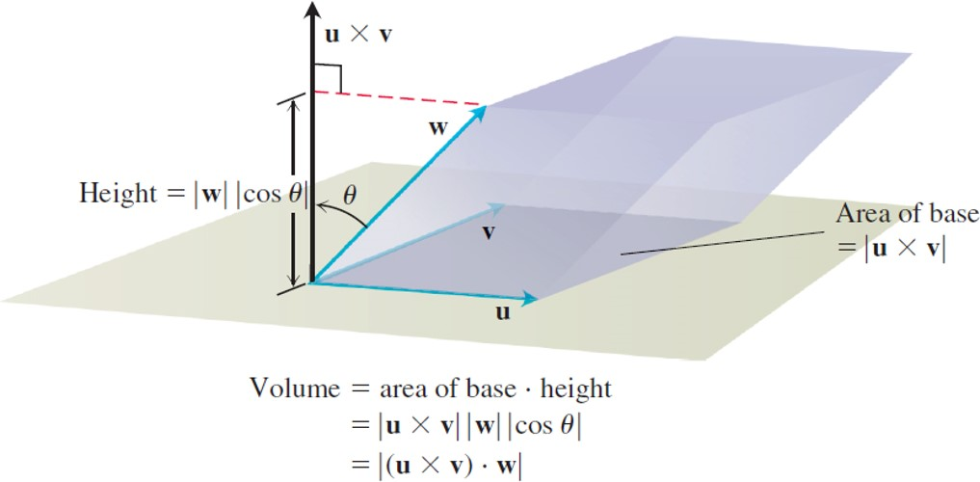
Triple Scalar or Box Product (1 of 3)
The number
is the volume of a
parallelepiped.
Notes:
The height of the parallelepiped is labeled magnitude of w cosine of theta. The cross product of u and v is orthogonal to vector u. The product vector makes an angle of theta with w. The area of base = the absolute value of start expression u times v end expression. The volume of the parallelepiped is determined by different vectors with the formula, volume = area of base times height. With the second equation = the absolute value of start expression u times v end expression the absolute value of w the absolute value of start expression cosine theta end expression. And with the third and last equation = the absolute value of start expression left parenthesis u cross v right parenthesis times w end expression.

Slide 84
Triple Scalar or Box Product (2 of 3)
Calculating the Triple Scalar Product as a Determinant

Slide 85
Triple Scalar or Box Product (3 of 3)
Example: Find the volume of the box
(parallelepiped) determined by
Solution: Using the rule for calculating a
determinant, we find
The volume is
units cubed.

Slide 86
Section 12.5 Lines and Planes in Space

Slide 87
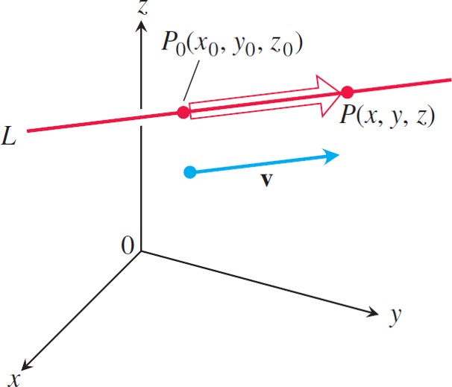
Lines and Line Segments in Space (1 of 11)
A point P lies on L through
parallel to v if and only if
is a scalar multiple of v.

Slide 88
Lines and Line Segments in Space (2 of 11)
Vector Equation for a Line
A vector equation for the line L through
parallel to v is
where r is the position vector of a point
on L and
is the position vector of

Slide 89
Lines and Line Segments in Space (3 of 11)
Parametric Equations for a Line
The standard parametrization of the line
through
parallel to
is

Slide 90
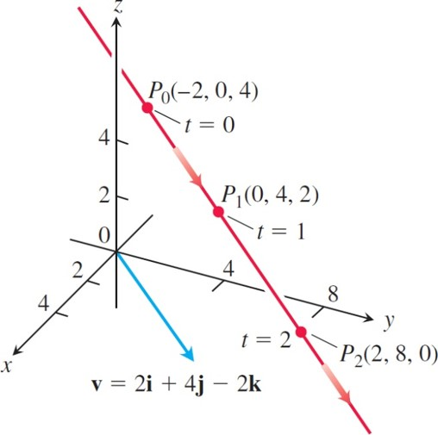
Lines and Line Segments in Space (4 of 11)
Selected points and parameter values on the line in the Example below. The arrows show the direction of increasing t.
Notes:
The direction is denoted by t. Two vectors lie within an x y z plane. Vector, v = 2 i + 4 j minus 2 k, is parallel to a line that passes through points P sub 0 (negative 2, 0, 4), P sub 1 (0, 4, 2), and P sub 2 (2, 8, 0). The values of t at P sub 0 and P sub 1 are 0 and 1, respectively.

Slide 91
Lines and Line Segments in Space (5 of 11)
Example: Find parametric equations for the line
through
parallel to
(See Figure above).
Solution: With
equal to
and

Slide 92
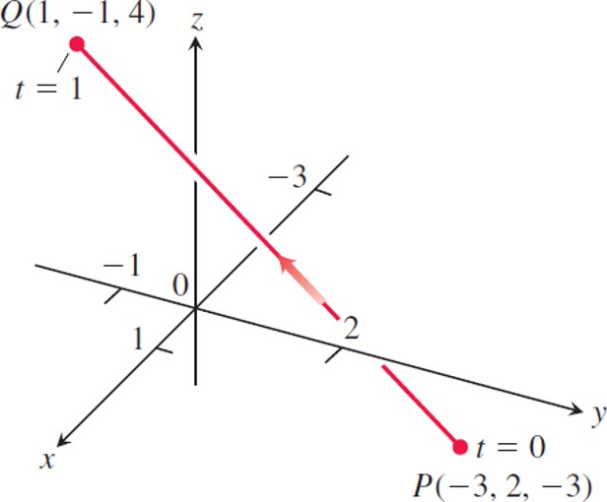
Lines and Line Segments in Space (6 of 11)
The Example below derives a parametrization of line segment P Q. The arrow shows the direction of increasing t.

Slide 93
Lines and Line Segments in Space (7 of 11)
Example: Parametrize the line segment joining the
points
Solution: We begin with equations for the line through P and Q, taking them, in this case,
We observe that the point

Slide 94
Lines and Line Segments in Space (8 of 11)
Solution (concluded):
on the line passes through
at t = 0 and
at t = 1. We add the restriction
to parametrize the segment:

Slide 95
Lines and Line Segments in Space (9 of 11)
Example: A helicopter is to fly directly from a helipad at the origin in the direction of the point (1, 1, 1) at a speed of 60 feet/seconds. What is the position of the helicopter after 10 seconds?
Solution: We place the origin at the starting position (helipad) of the helicopter. Then the unit vector

Slide 96
Lines and Line Segments in Space (10 of 11)
Solution (continued):
gives the flight direction of the helicopter. The position of the helicopter at any time t is

Slide 97
Lines and Line Segments in Space (11 of 11)
Solution (concluded):
When t = 10 seconds,
After 10 seconds of flight from the origin toward (1, 1, 1),
the helicopter is located at the point
in space. It has traveled a distance of (60 feet/seconds)
which is the length of the vector

Slide 98
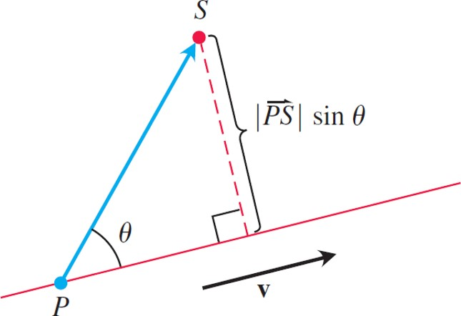
The Distance from a Point to a Line in Space (1 of 4)
The distance from S to the line through P parallel to
is the angle between
Notes:
The point, p, is parallel to a vector, v. A point in an upward direction labeled, S, cuts an angle theta with the line at P. The length of the perpendicular dashed line dropped from point S to vector v is the absolute value of start expression P S end expression sine of theta.

Slide 99
The Distance from a Point to a Line in Space (2 of 4)
Distance from a Point S to a Line Through P Parallel to v

Slide 100
The Distance from a Point to a Line in Space (3 of 4)
Example 5: Find the distance from the point
to the line
Solution: We see from the equations for L that L
passes through
With

Slide 101
The Distance from a Point to a Line in Space (4 of 4)
Solution (concluded):
and
The Equation gives

Slide 102
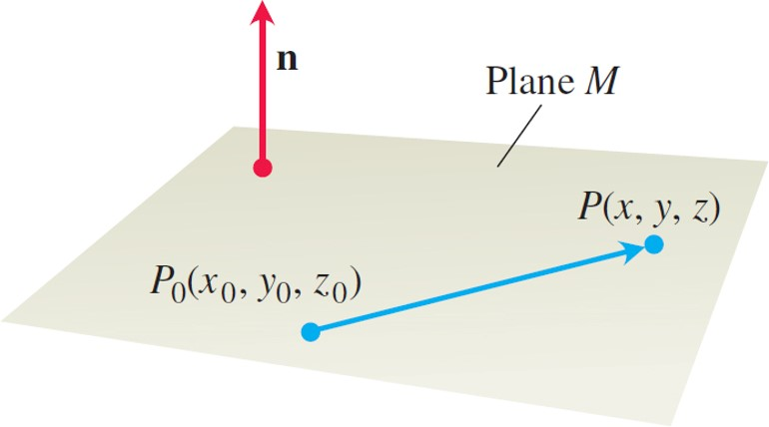
An Equation for a Plane in Space (1 of 5)
The standard equation for a plane in space is defined in terms of a vector normal to the plane: A point P lies in
the plane through
normal to n if and only if

Slide 103
An Equation for a Plane in Space (2 of 5)
Equation for a Plane
The plane through
normal to
Vector equation:
Component equation:
Component equation simplified:

Slide 104
An Equation for a Plane in Space (3 of 5)
Example: Find an equation for the plane through
perpendicular to
Solution: The component equation is
Simplifying, we obtain

Slide 105
An Equation for a Plane in Space (4 of 5)
Example: Find an equation for the plane through
Solution: We find a vector normal to the plane and use it with one of the points to write an equation for the plane.
The cross product

Slide 106
An Equation for a Plane in Space (5 of 5)
Solution (concluded):
is normal to the plane. We substitute the components
of this vector and the coordinates of
into the component form of the equation to obtain

Slide 107
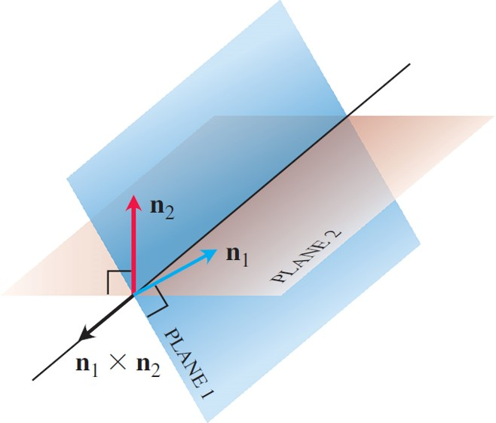
Lines of Intersection (1 of 6)
How the line of intersection of two planes is related to the planes’ normal vectors.

Slide 108
Lines of Intersection (2 of 6)
Example: Find a vector parallel to the line of
intersection of the planes
and

Slide 109
Lines of Intersection (3 of 6)
Solution: The line of intersection of two planes is
perpendicular to both planes’ normal vectors
and therefore parallel to
Turning this around,
is a vector parallel to the planes’ line of
intersection. In our case,
Any nonzero scalar multiple of
will do as well.

Slide 110
Lines of Intersection (4 of 6)
Example: Find the point where the line
intersects the plane

Slide 111
Lines of Intersection (5 of 6)
Solution: The point
lies in the plane if its coordinates satisfy the equation of the plane, that is, if

Slide 112
Lines of Intersection (6 of 6)
Solution (concluded):
The point of intersection is

Slide 113
The Distance from a Point to a Plane (1 of 5)
Distance from a Point S to a Plane with Normal n at Point P

Slide 114
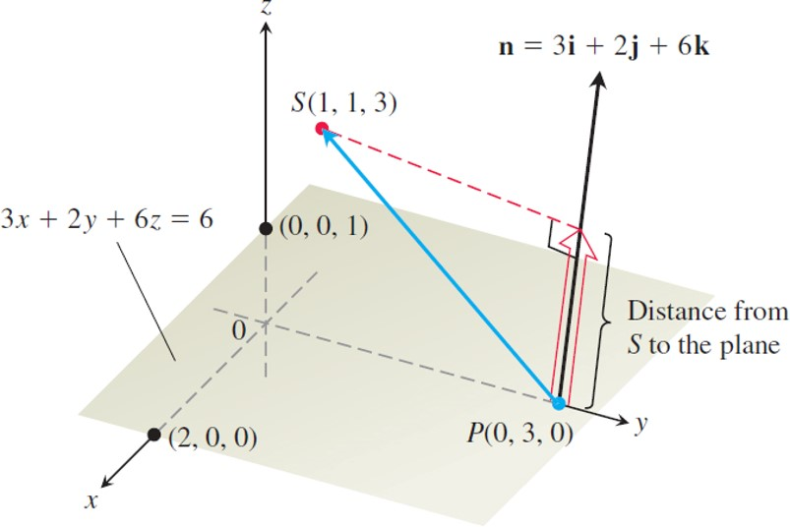
The Distance from a Point to a Plane (2 of 5)
The distance from S to the plane is the length of the
vector projection of
onto n.
Notes:
The graph plots a plane that represents the equation 3 x + 2 y + 6 z = 6. The following points are marked on the plane with (2, 0, 0) at x, (0, 0, 1) at y, and P (0, 3, 0) at z. The normal vector to the plane on point P is n = 3 i + 2 j + 6 k. Point S with coordinates (1, 1, 3) is connected to point P. A perpendicular line, from point S to vector n as a dashed line, completes a triangle. The base of the triangle is labeled, distance from S to the plane.

Slide 115
The Distance from a Point to a Plane (3 of 5)
Example: Find the distance from
to the
plane
Solution: We find a point P in the plane and
calculate the length of the vector projection of
onto a vector n normal to the plane. The coefficients
in the equation
give

Slide 116
The Distance from a Point to a Plane (4 of 5)
Solution (continued):
The points on the plane easiest to find from the plane’s equation are the intercepts. If we take P to be the y-intercept (0, 3, 0), then

Slide 117
The Distance from a Point to a Plane (5 of 5)
Solution (concluded):
Therefore, the distance from S to the plane is

Slide 118
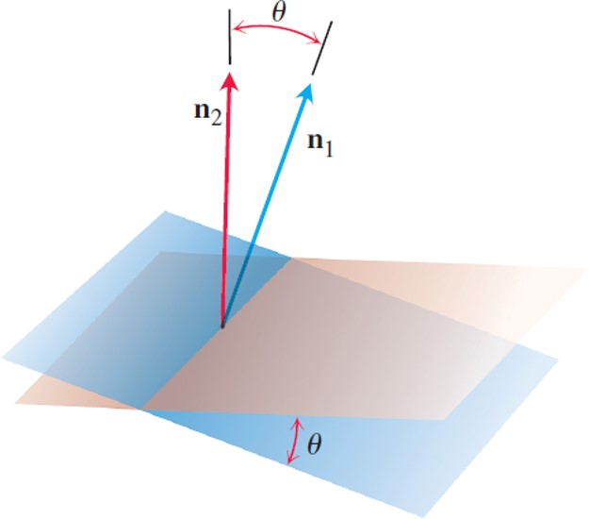
Angles Between Planes (1 of 2)
The angle between two planes is obtained from the angle between their normals.

Slide 119
Angles Between Planes (2 of 2)
Example: Find the angle between the planes
Solution: The vectors
are normals to the planes. The angle between them is

Slide 120
Section 12.6 Cylinders and Quadric Surfaces

Slide 121
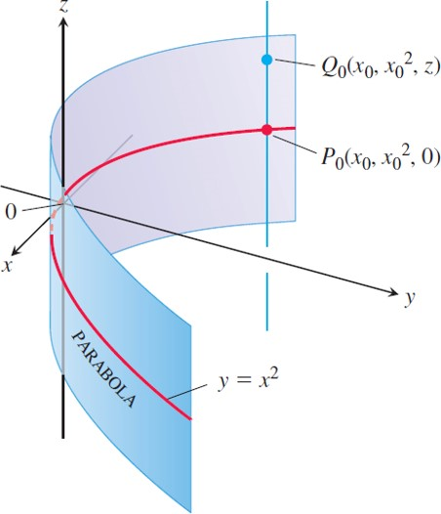
Cylinders (1 of 3)
Every point of the cylinder has coordinates of the
form
We call it “the cylinder

Slide 122
Cylinders (2 of 3)
Example: Find an equation for the cylinder made by the lines parallel to the z-axis that pass through
the parabola
Solution: The point
lies on the parabola
in the x y-plane. Then, for any value of z, the
point
lies on the cylinder because it lies
on the line
parallel to the
z-axis.

Slide 123
Cylinders (3 of 3)
Solution (concluded):
Regardless of the value of z, therefore, the points on the surface are the points whose coordinates
satisfy the equation
This makes
an equation for the cylinder. Because of this, we call
the cylinder “the cylinder

Slide 124
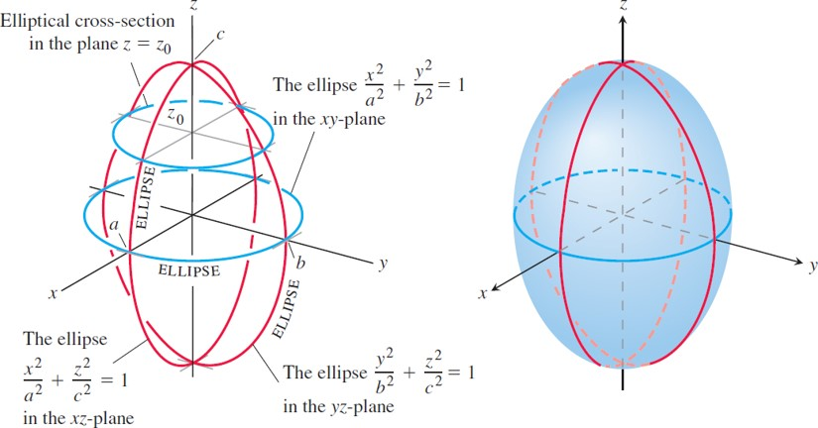
Quadric Surfaces (1 of 8)
The ellipsoid
has elliptical cross-sections in each of the three coordinate planes.
Notes:
The first graph plots the cross section of the ellipsoid as three ellipses. Points A, B, and C are on the x axis, y axis, and z axis, respectively. The ellipse for equation start fraction x squared over a squared end fraction + start fraction z squared over c squared end fraction = 1 is in the x z plane. The ellipse for start fraction y squared over b squared end fraction + start fraction z squared over c squared end fraction = 1 is in the y z plane. And the ellipse for equation start fraction x squared over a squared end fraction + start fraction y squared over b squared end fraction = 1 is in the x y plane. The elliptical cross section is in plane z = z sub 0. The second graph plots an ellipsoid for equation start fraction x squared over a squared end fraction + start fraction y squared over b squared end fraction + start fraction z squared over c squared end fraction = 1.

Slide 125
Quadric Surfaces (2 of 8)
Example: The ellipsoid
cuts the coordinate axes at
and
It lies within the rectangular box defined by
the inequalities
The surface
is symmetric with respect to each of the coordinate planes because each variable in the defining equation is squared.

Slide 126
Quadric Surfaces (3 of 8)
Example (continued):
The curves in which the three coordinate planes cut the surface are ellipses. For example,
The curve cut from the surface by the plane
is the ellipse

Slide 127
Quadric Surfaces (4 of 8)
Example (concluded):
If any two of the semiaxes a, b, and c are equal, the surface is an ellipsoid of revolution. If all three are equal, the surface is a sphere.

Slide 128
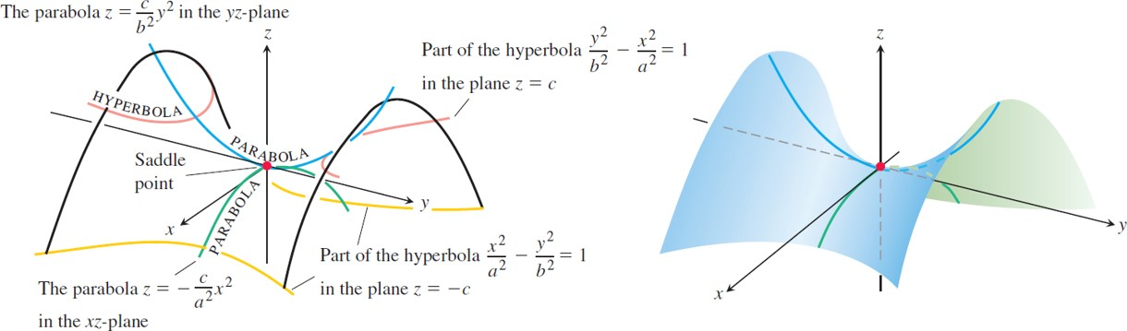
Quadric Surfaces (5 of 8)
The hyperbolic paraboloid
The cross-sections in planes perpendicular to the z-axis above and below the x y-plane are hyperbolas. The cross-sections in planes perpendicular to the other axes are parabolas.
Notes:
The first graph plots the cross section of a hyperbolic paraboloid in two hyperbolas and two parabolas. The parabola for equation, z =start fraction c over b squared end fraction y squared, is in y z plane with the vertex at the origin. The parabola for equation, z = negative start fraction c over a squared end fraction x squared, is in the x z plane with vertex at the origin. A part of the hyperbola for equation, start fraction y squared over b squared end fraction minus start fraction x squared over a squared = 1, is in plane z = c. The hyperbola is plotted at the top end of the curve. A part of the hyperbola for equation, start fraction x squared over a squared end fraction minus start fraction y squared over b squared = 1, is in plane z = negative c. The second graph plots the hyperbolic paraboloid with the saddle point at the origin.

Slide 129
Quadric Surfaces (6 of 8)
Example: The hyperbolic paraboloid
has symmetry with respect to the planes x = 0 and y = 0. The cross-sections in these planes are

Slide 130
Quadric Surfaces (7 of 8)
Example (continued):
If we cut the surface by a plane
the cross-section is a hyperbola,
with its focal axis parallel to the y-axis and its vertices on the parabola.

Slide 131
Quadric Surfaces (8 of 8)
Example (concluded):
To a person traveling along the surface in the y z-plane the origin looks like a minimum. To a person traveling the x z-plane the origin looks like a maximum. Such a point is called a saddle point of a surface

Slide 132
General Quadric Surfaces (1 of 4)
The general equation of second degree in three variables x, y, z is
where A, B, C, D, E, F, G, H, I, and J are constants.

Slide 133
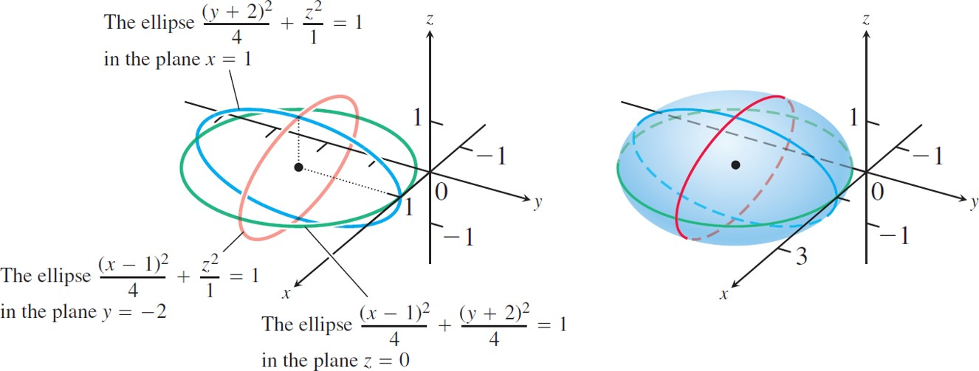
General Quadric Surfaces (2 of 4)
An ellipsoid centered at the point
Notes:
The first graph plots the ellipsoid into three ellipses. The equation, start fraction left parenthesis x minus 1 right parenthesis squared over 4 end fraction + start fraction z squared over 1 end fraction = 1, has an ellipse in the plane at y = negative 2. The equation, start fraction left parenthesis y + 2 right parenthesis squared over 4 end fraction + start fraction z squared over 1 end fraction = 1, has an ellipse in the plane at x = 1. The equation, start fraction left parenthesis x minus 1 right parenthesis squared over 4 end fraction + start fraction left parenthesis y + 2 right parenthesis squared over 4 end fraction = 1, has an ellipse in the plane at z = 0, where the ellipse is a square. The second graph plots an ellipsoid centered at (1, negative 2, 0).

Slide 134
General Quadric Surfaces (3 of 4)
Example: Identify the surface given by the equation
Solution: We complete the squares to simplify the expression:

Slide 135
General Quadric Surfaces (4 of 4)
Solution (concluded):
We can rewrite the original equation as
This is the equation of an ellipsoid whose three semiaxes have lengths 2, 2, and 1 and which is
centered at the point

Slide 136

Copyright
This work is protected by United States copyright laws and is provided solely for the use of instructors in teaching their courses and assessing student learning. Dissemination or sale of any part of this work (including on the World Wide Web) will destroy the integrity of the work and is not permitted. The work and materials from it should never be made available to students except by instructors using the accompanying text in their classes. All recipients of this work are expected to abide by these restrictions and to honor the intended pedagogical purposes and the needs of other instructors who rely on these materials.

